Slide 1
Chapter 1. Introduction
Financial Econometrics
Department of financial engineering
Zhongnan university of economics and law
Xu Yonghao

Slide 2
Introduction
Name: Xu Yonghao（许泳昊）
Email: xuyonghao@zuel.edu.cn
Office: wenquan 416
QQ: 429496251
Research Interest: Behavioral Finance;
Fintech; Asset Pricing; Corporate Finance

Slide 3
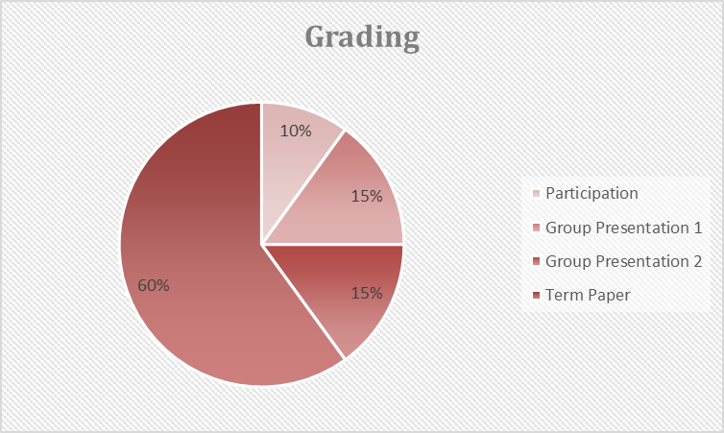
Grading

Slide 4
TextBooks

Slide 5
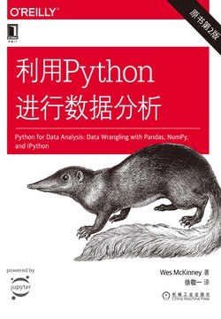
TextBooks

Slide 6
COURSE SCHEDULE
Time | Schedule
Week1 | Introduction to Financial Econometrics
Week2 | Statistical Foundations
Week3 | Overview of OLS
Week4 | Instrumental Variable Regression
Week5 | Panel Data and OLS
Week6 | Fama-MacBeth Regression
Week7 | Event Studies in Asset Pricing
Week8 | Group Presentation1: Research Proposal
Week9 | Case Study: Computer Class
Week10 | Limited Dependent Variable Models
Week11 | Matching Models
Week12 | Generalized Method Of Moments
Week13 | Time Series Model 1
Week14 | Time Series Model 2
Week15 | Vector Autoregressive Model
Week16 | Group Presentation2: Final Project
6

Slide 7
GROUP PRESENTATION
Preparation for the team cases is done in groups of four or less.
Only one team members need to present the final work.
Presentation 1. Proposal
Presentation 2. Term Paper
Why you choose the topic.
Contribution of your work.
Literature review of related work.
Data preparation and summary.
Empirical Design.
Why you choose the topic.
Contribution of your work.
Summary statistics.
Empirical Results.
Conclusion.

Slide 8
oUTLINE
Financial Problems
Literature
Statistical Software
Proposal
Term Paper

Slide 9
1. Financial Problems
1 Asset Pricing
2 Corporate Finance
3 Household Finance
4 Financial Intermediation
5 Macro-finance (Macroeconomics)

Slide 10
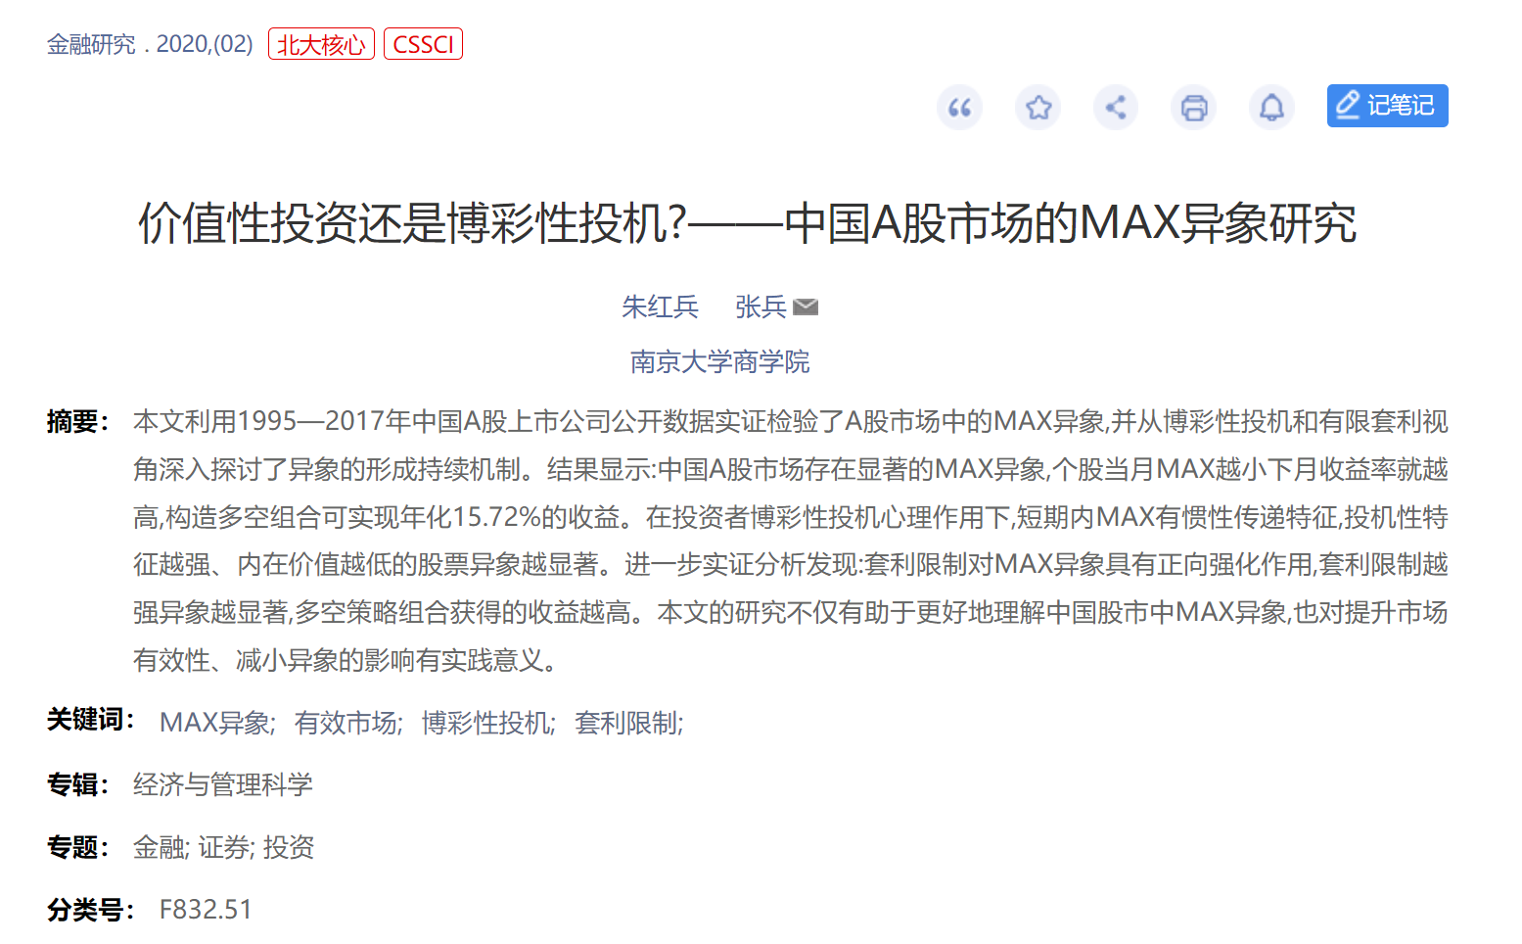
1.1 Asset Pricing

Slide 11

1.1 Asset Pricing

Slide 12
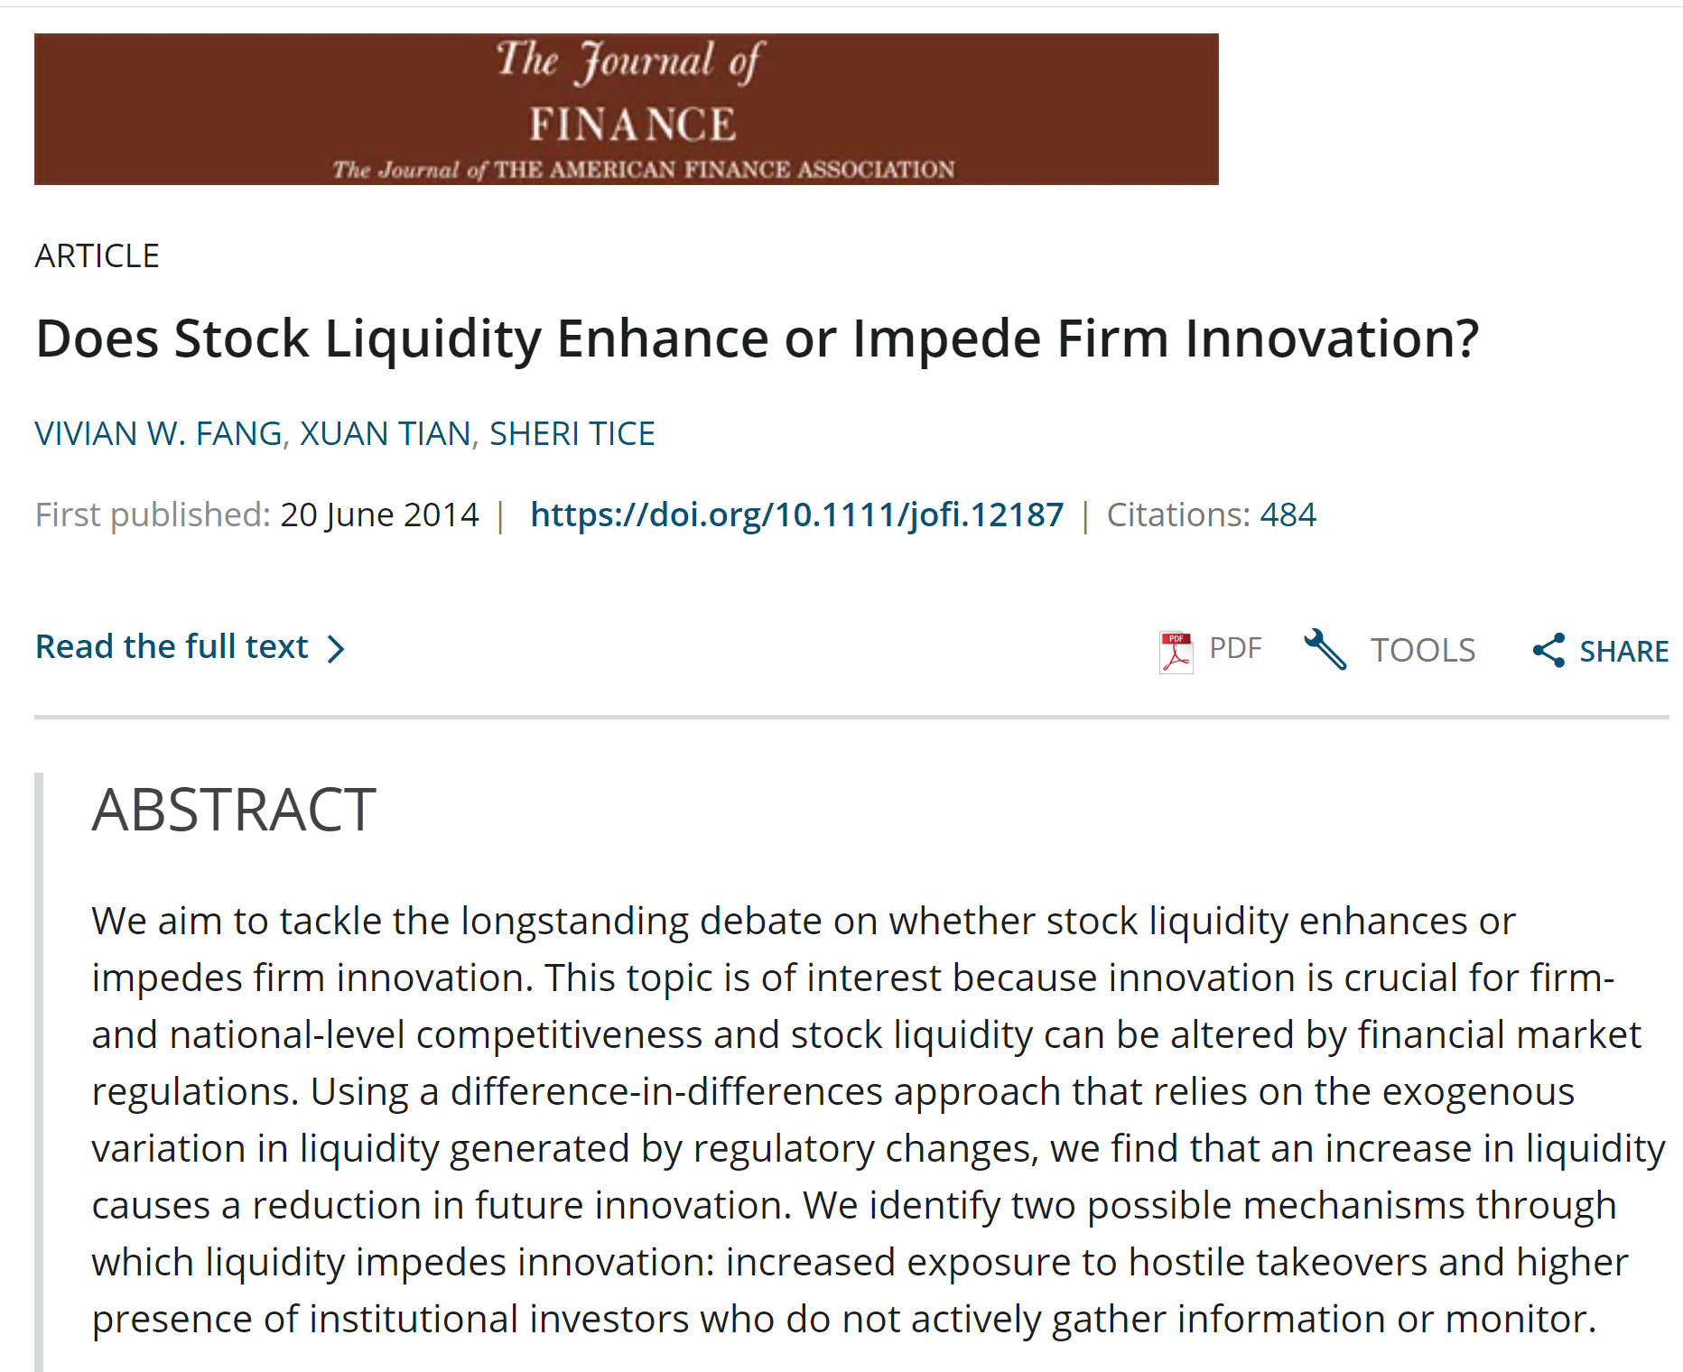
1.2 Corporate Finance

Slide 13
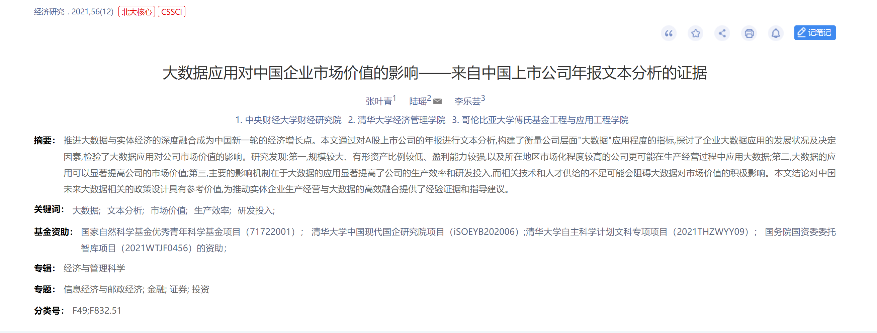
1.2 Corporate Finance

Slide 14
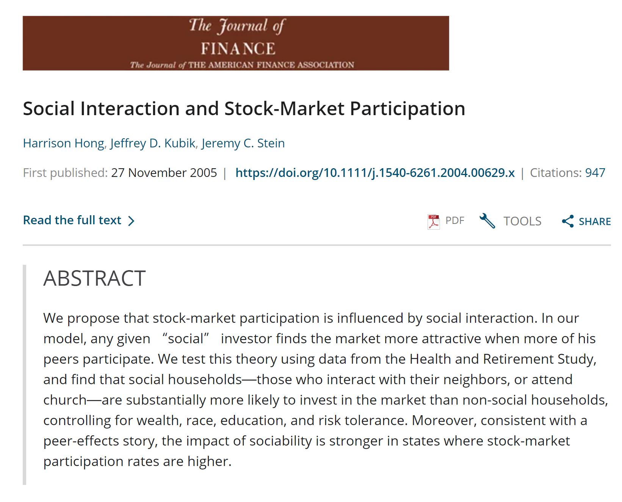
1.3 Household Finance

Slide 15
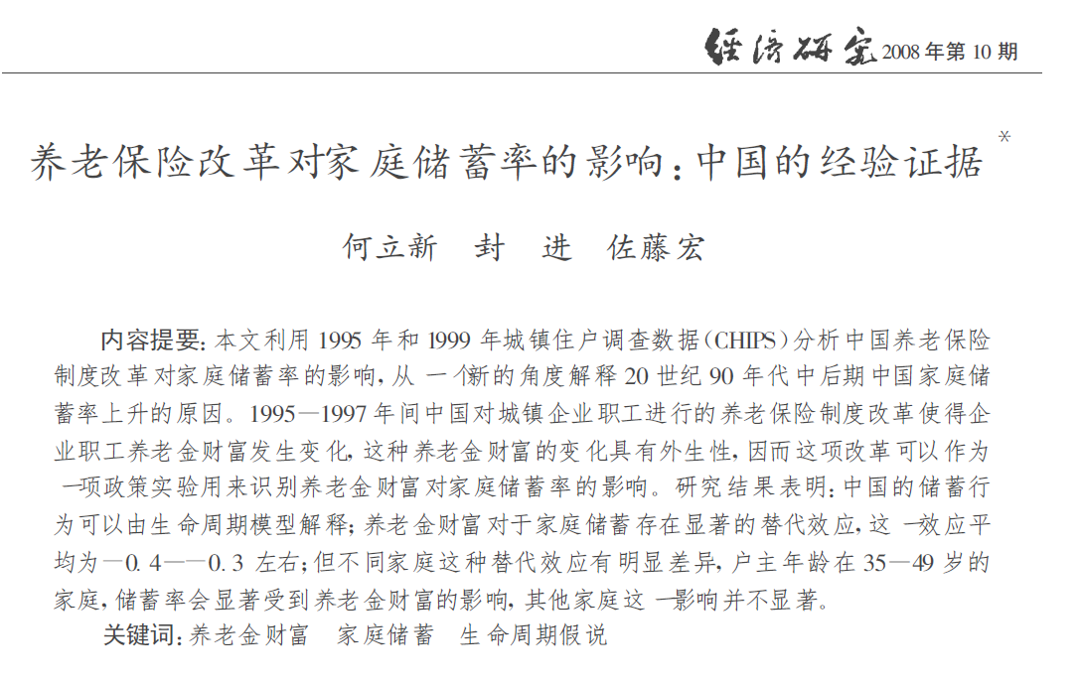
1.3 Household Finance

Slide 16

1.4 Financial Intermediation

Slide 17
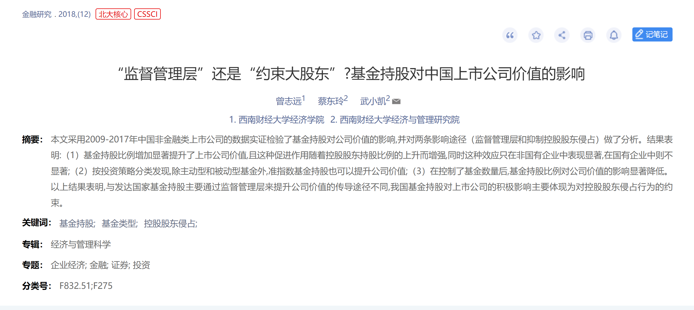
1.4 Financial Intermediation

Slide 18
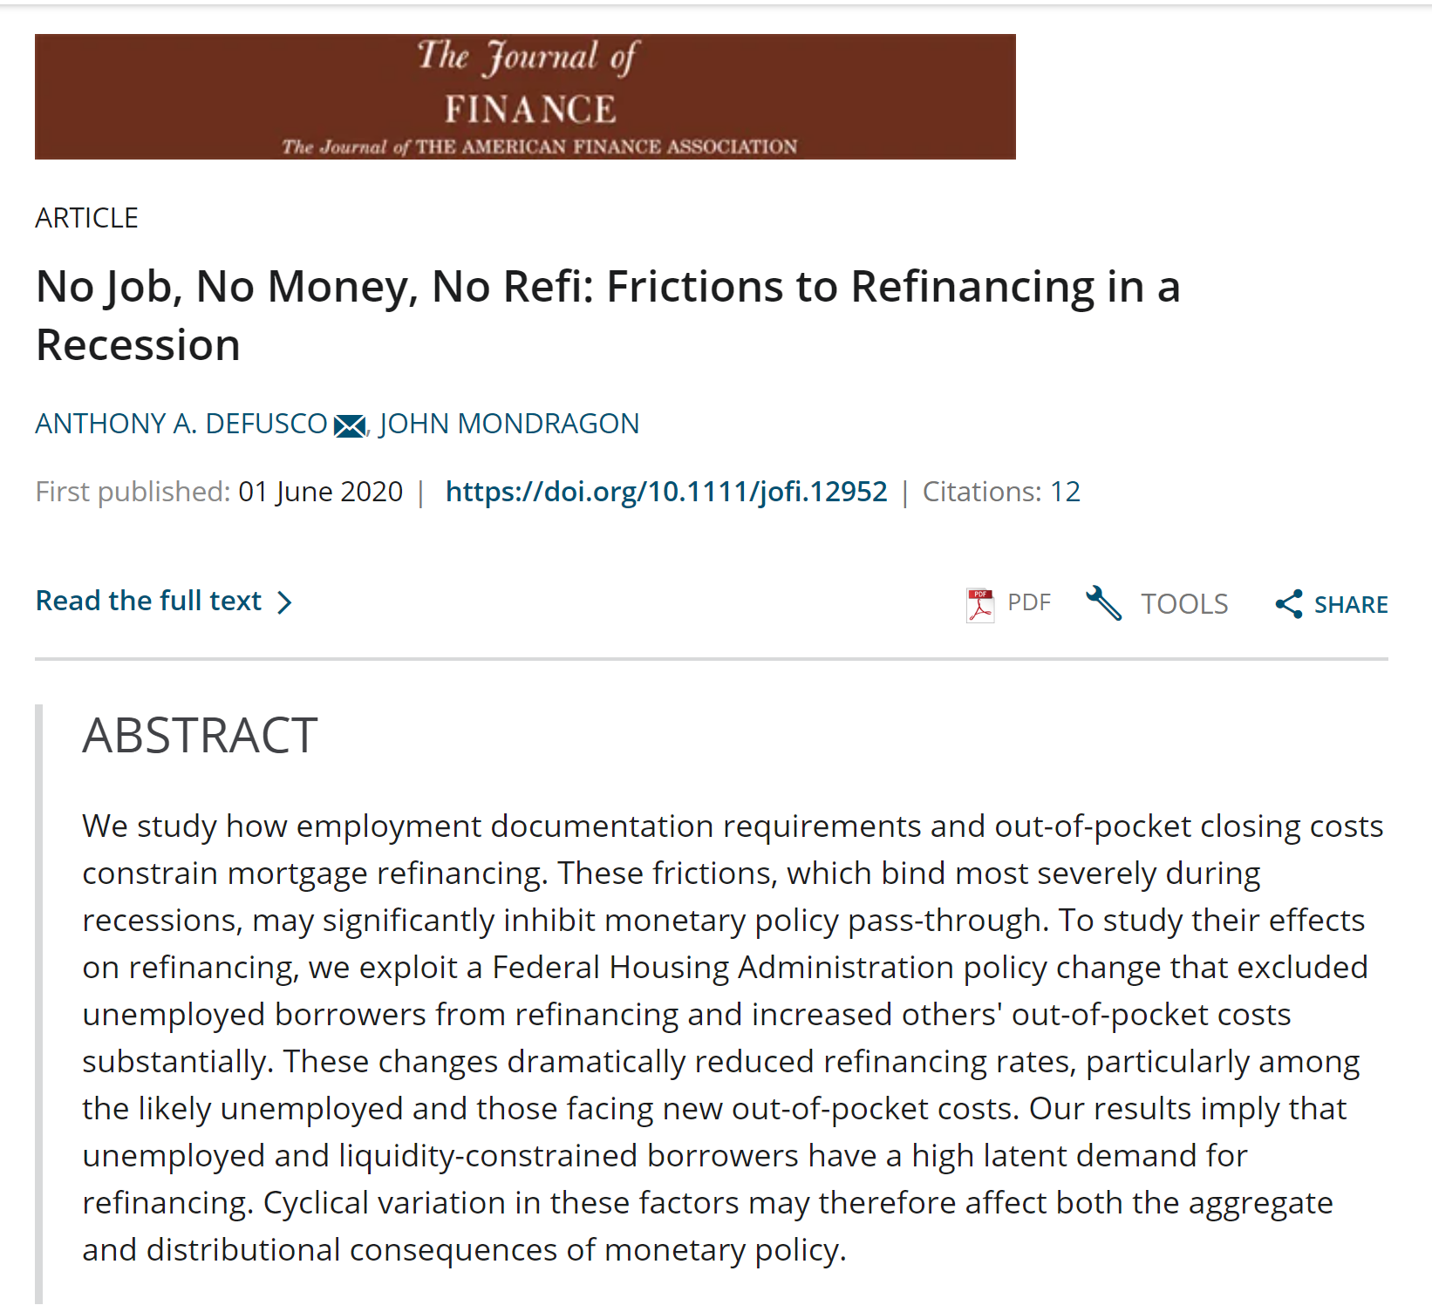
1.5 Macro-finance (Macroeconomics)

Slide 19
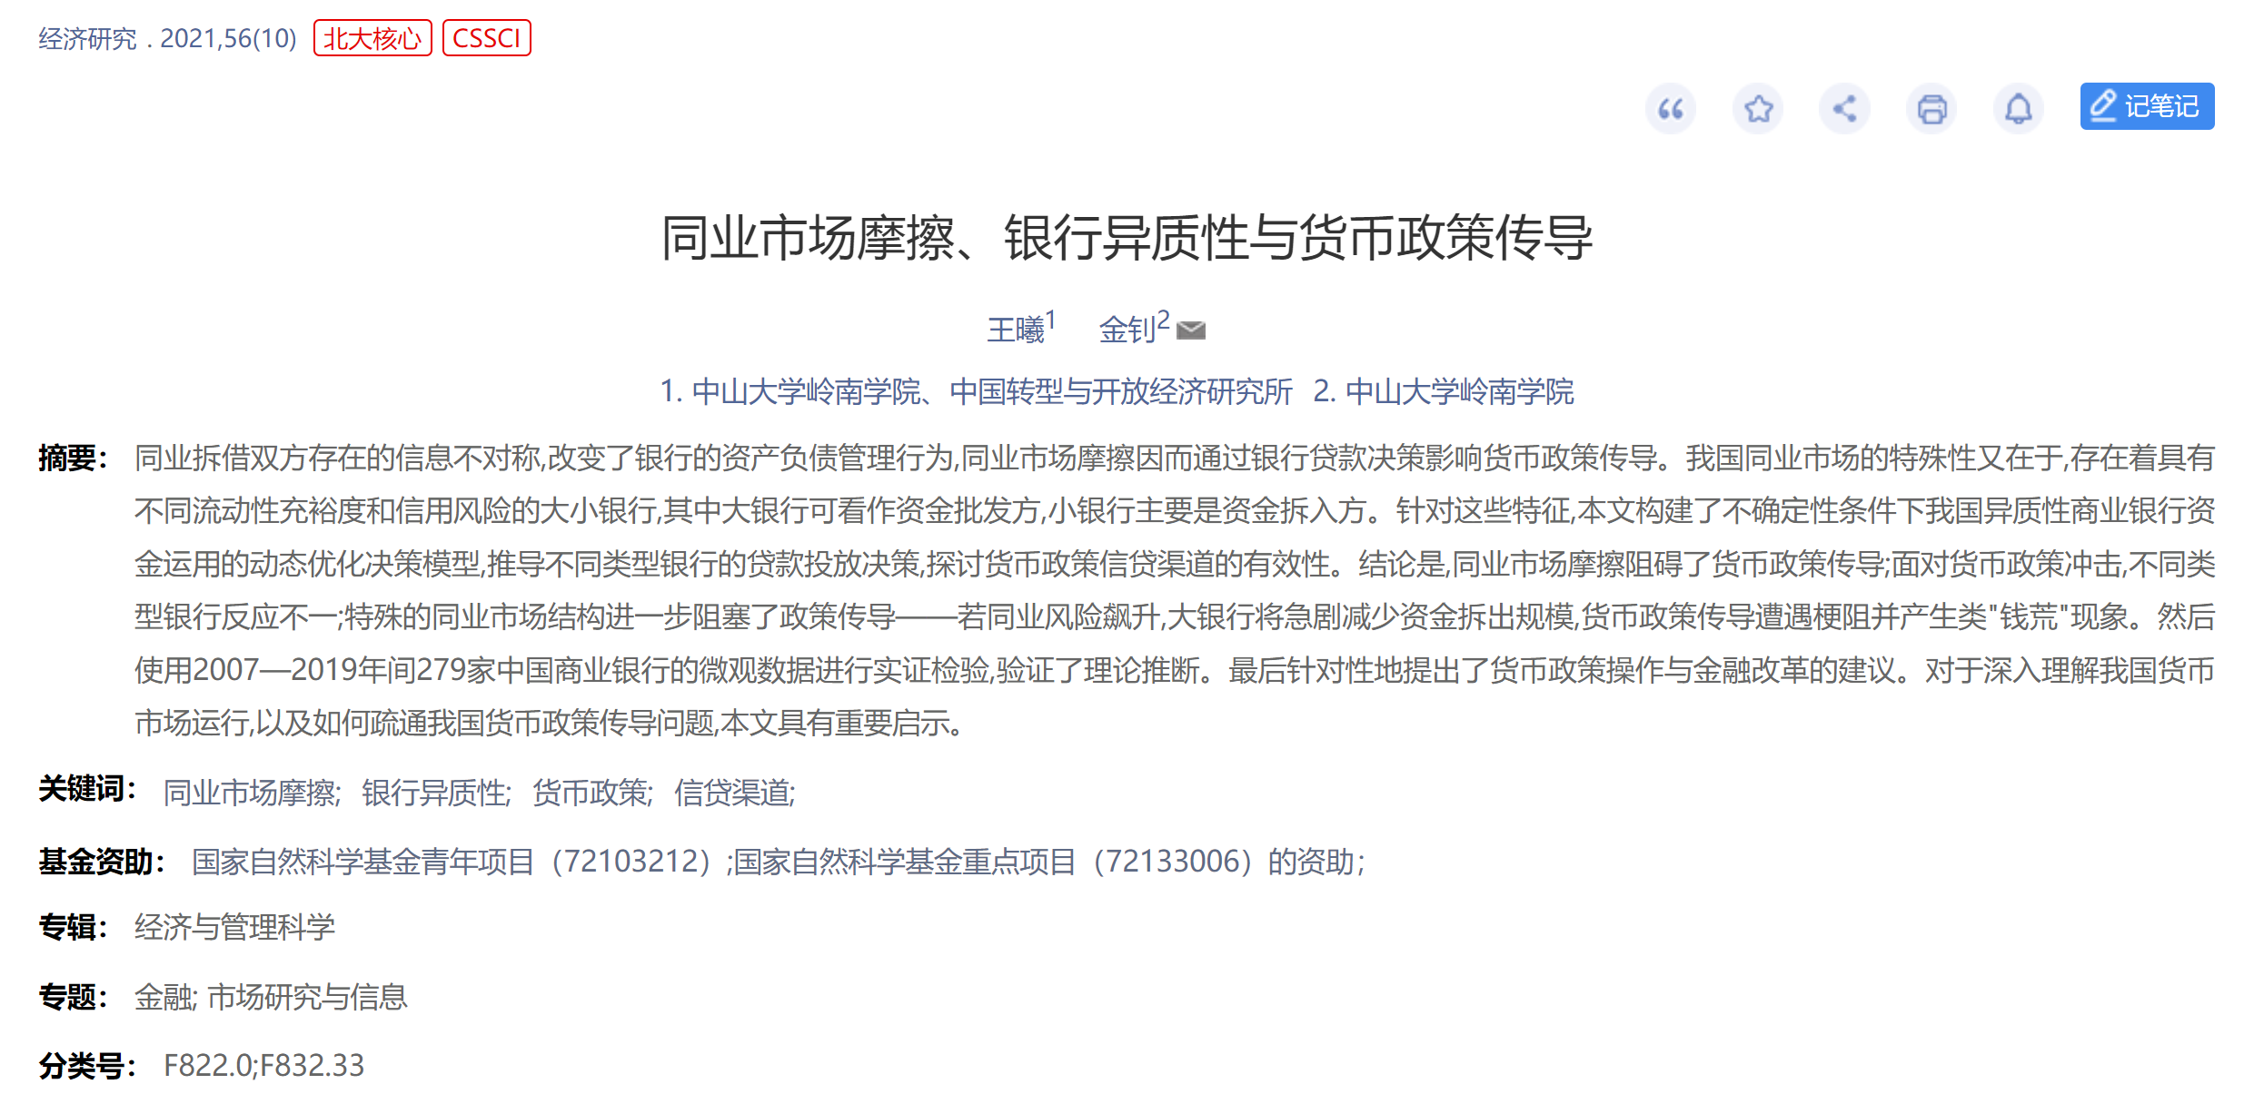
1.5 Macro-finance (Macroeconomics)

Slide 20
2. Literature
知网
Google Scholar
https://www.connectedpapers.com/

Slide 21
3 Statistical Software
Stata
SAS
Matlab
Eviews
Python

Slide 22
4 Proposal
Why
Contribution
Literature
Data
Design.

Slide 23
4.1 Proposal - DATA
In the first presentation, all groups need to show their evidence of all the data needed to finish the term paper.
2. After the second presentation, the data and code should be submitted along with the term paper.

Slide 24
4.1 Proposal - DATA
CSMAR
WIND
RESSET
CNRDS
WRDS (Global Data and U.S. Data)

Slide 25
5 Term Paper
Format
《经济研究》;《American Economic Review》
Word Counts
8000 -15000
Contribution of Every Teammates (Another Single File)
 | A | B | C | D
论文设计 | 100% | 0% | 0% | 0%
文献综述 | 50% | 50% | 0% | 0%
实证 | 0% | 0% | 100% | 0%
写作 | 0% | 0% | 0% | 100%

